Slide 2
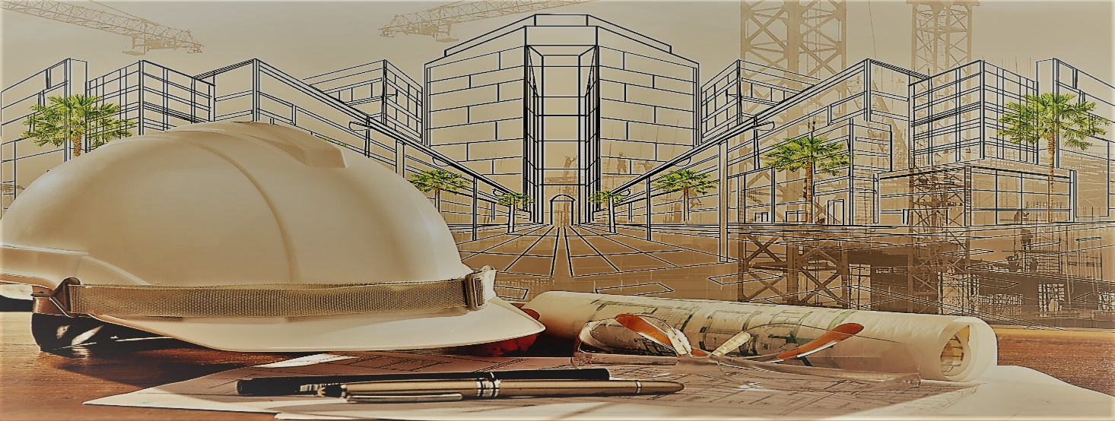
A Company is as good as the people running the show.
Team Otex is Strong with a cumulative team
Experience of 40 + Years and expertise of handing
All sizes of projects with the best brands in the country.

Slide 3
Thinking OTEX :-
In each of our project, be it interiors for residential, commercial, individual or large-scale projects,
Yow will find coming together of simplicity and elegance.
Our four-stage approach :
MEET
DESIGN
EXECUTION
DELIVERY
We take time to listen to understand your needs, desires and priorities.
You are part of our design process. It is an extension of your vision, our design and execution.
We work closely with you towards project delivery on all parameters as per brief – be it the timeline, quality or budget. Regular reports keep you updated of the progress at every stage.
We don’t delivery just projects, we build relationships. Each project is the base for connections which lead from strength to strength.

Slide 4
Understanding OTEX :-
To ensure your convenience above all, we do one thing exceptionally well.
That one thing percolates in every little thought, design and act of ours.
It is the reason why we exist, why do the things we do, and why the results are what they are.
That one things is “understanding you”.
The Result :-
New interior ideas for a brave new world. Space configurations that align with maximizing your convenience today and can adapt to whatever comes next.

Slide 5
In House Expertise :-
DESIGNERS - 04
FURNITURE WORKERS - 46
MEP - 16
CIVIL & GYPSUM - 30
PAINTING - 12
PROJECT EXECUTION - 08
PROCUREMENT - 02

Slide 6
Delivering OTEX :-
THE CAPABILITY
We adhere to timely execution, a high standard of proficiency, good quality in design and superior
Construction in all our projects.
Design-Build and Turnkey interior contracting services with a single point of contact.
Cumulative experience of 40+ years of the leaders along with their varied strengths in
handling medium and large-scale projects.
A fully capable in-house Architects, MEP Consultants and Interior Designers team, facilitating
Individually assigned teams.
In-house readily available labour force at all times.
Specialization in creation of spaces which create an emotional and spiritual experience leading
To a consistent positive vibe in productivity.

Slide 7
A process which involves :-
1. Initial Consultation – Meeting, brainstorming & agreeing on overall concepts timelines & execution
details.
2. Concept & Design – Integrating your vision through design.
3. Execution & Implementation – Strategically constructing to ensure visions & plans become reality.
4. Project Management – Overseeing collaboration to achieve project goals.
5. Project Close-up & Handover – Bringing it all together for a smooth transition.
6. Follow up & Evaluation – Walking the client through post-creation utility & maintenance.

Slide 8
Delivering OTEX :-
THE PROCESS
Thanks to our clearly defined processes, our clients enjoy the following advantages all over India.
We have streamlined project operations, creating efficiencies to ensure each project is
Delivering to the brief, on time and budget
We have constant access to local execution teams. They are guided by our Project Trams who
Are in touch with the client throughout the lifecycle of the project.
A single-point team lead makes it easy for clients to coordinate.
Our safe and healthy workspaces, top-of-the-line equipment and adherence to safety procedures
Are in line with safety, Health and Environment Standards.

Slide 10
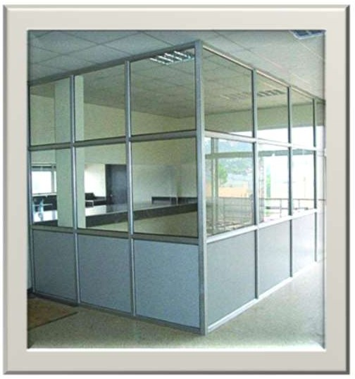
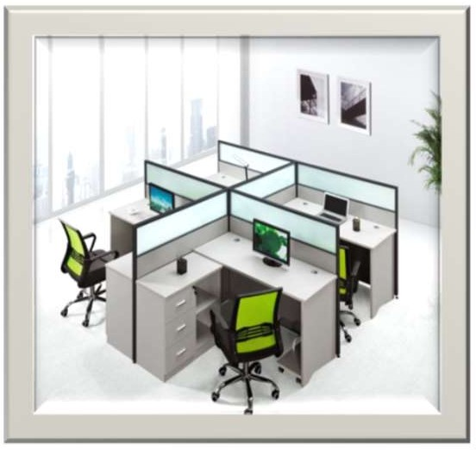
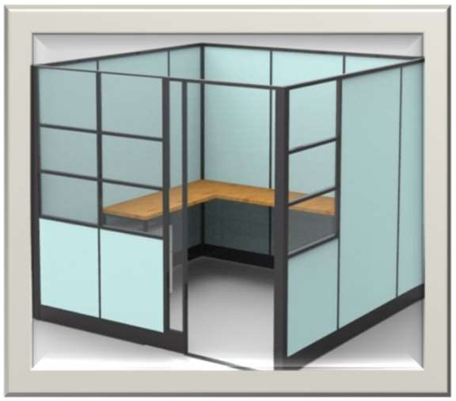
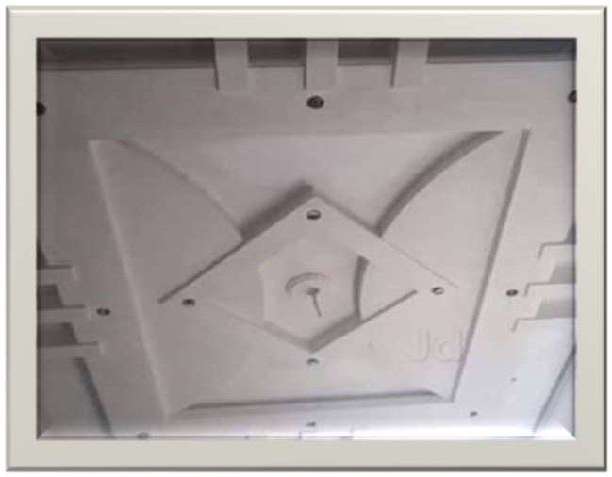
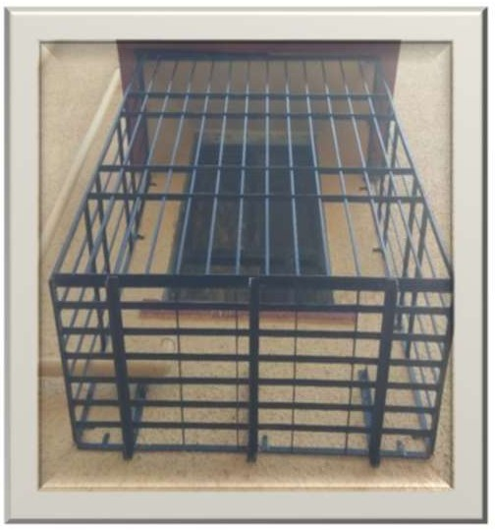
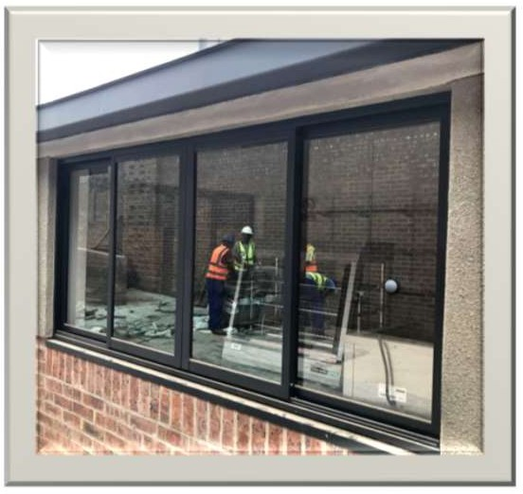
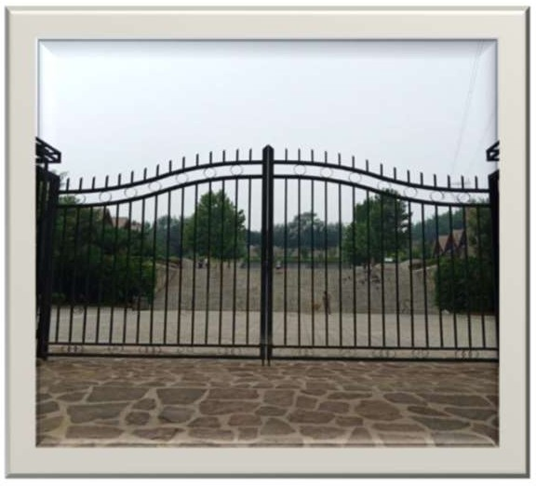
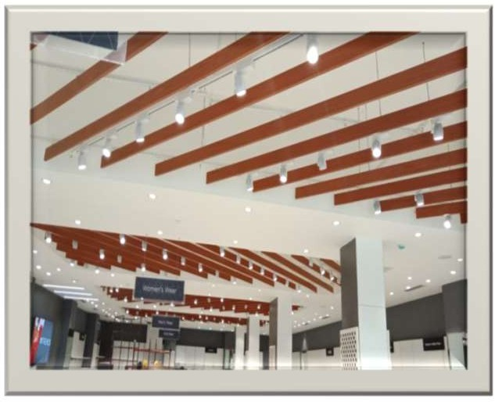

Slide 11
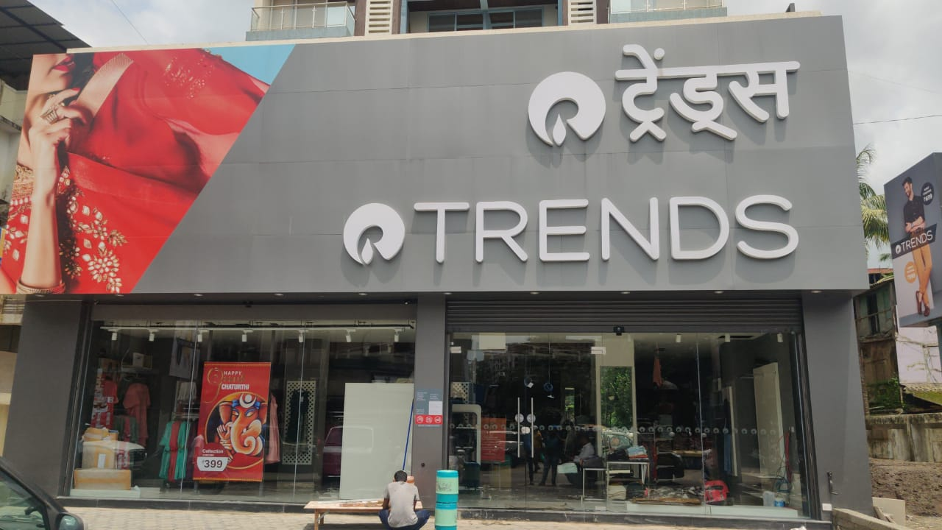
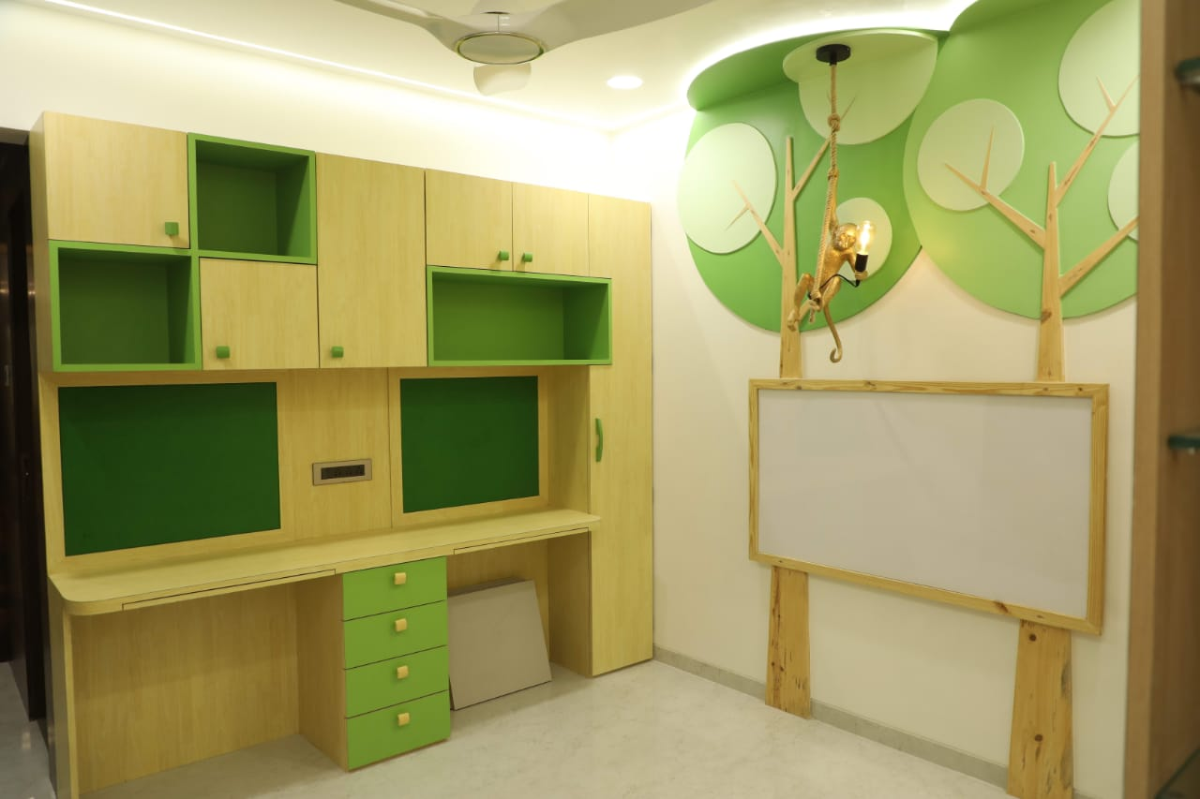
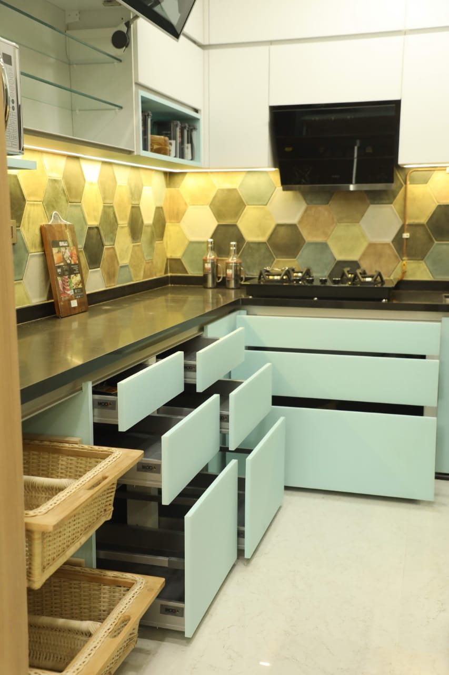
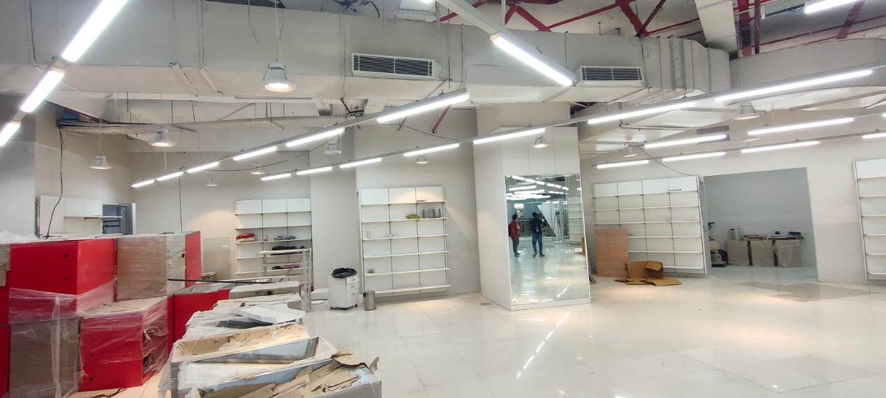
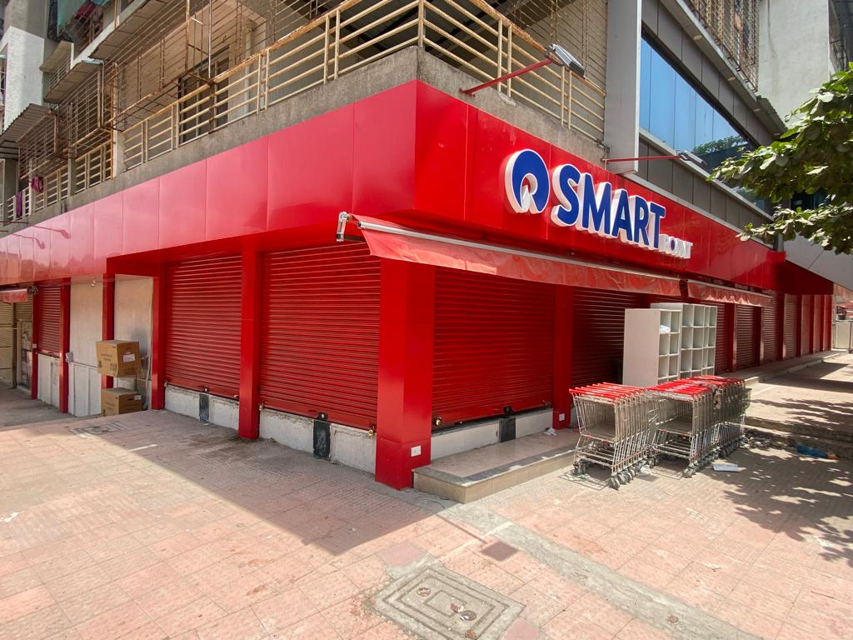
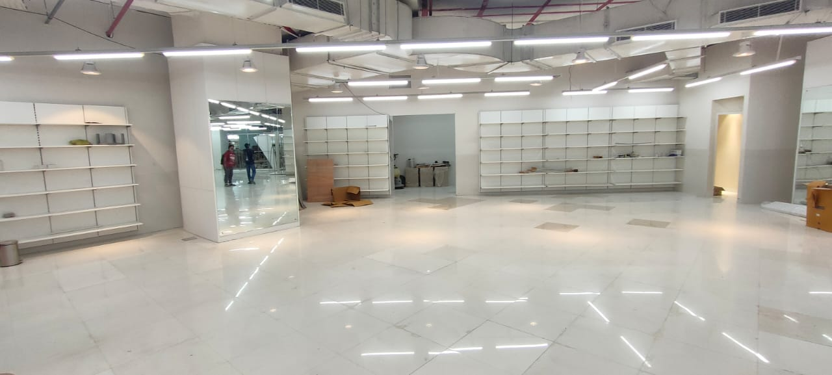

Slide 12
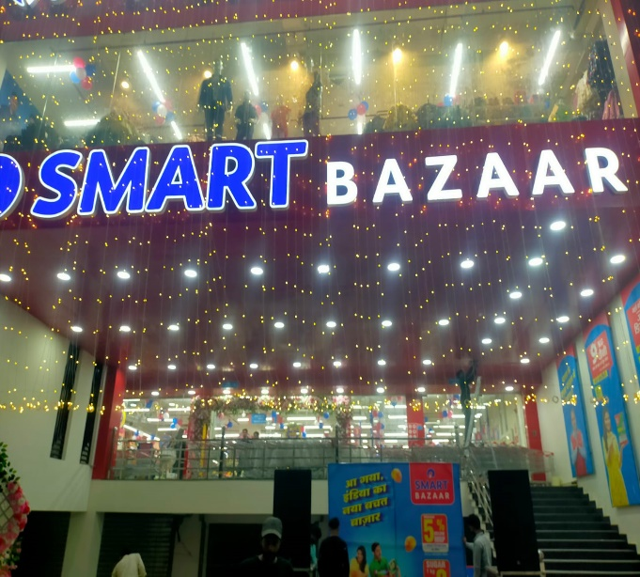
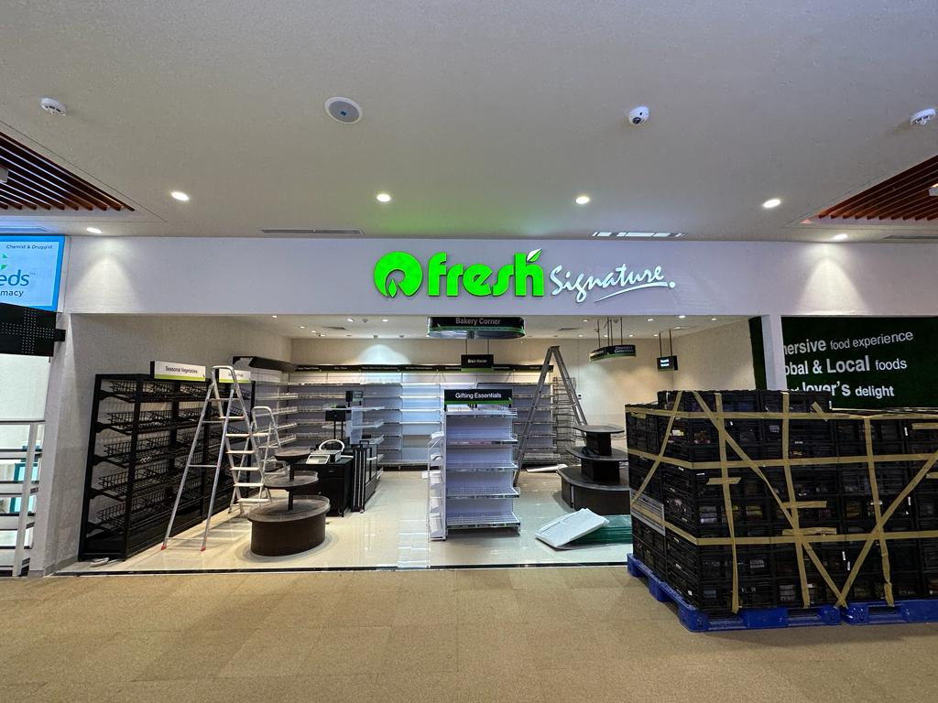
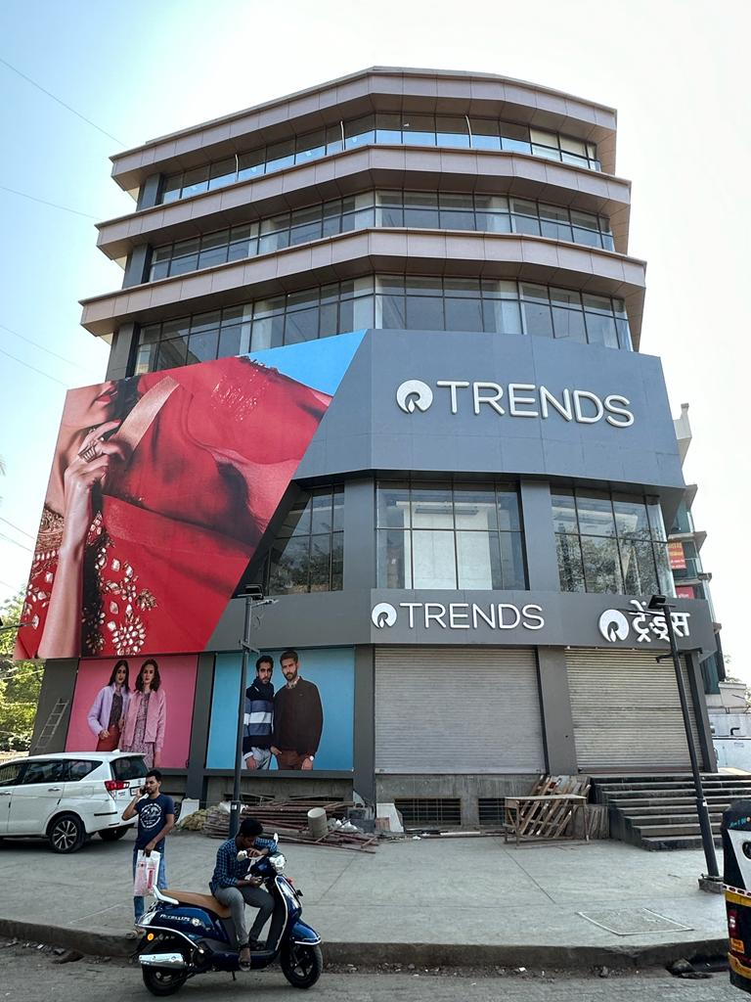
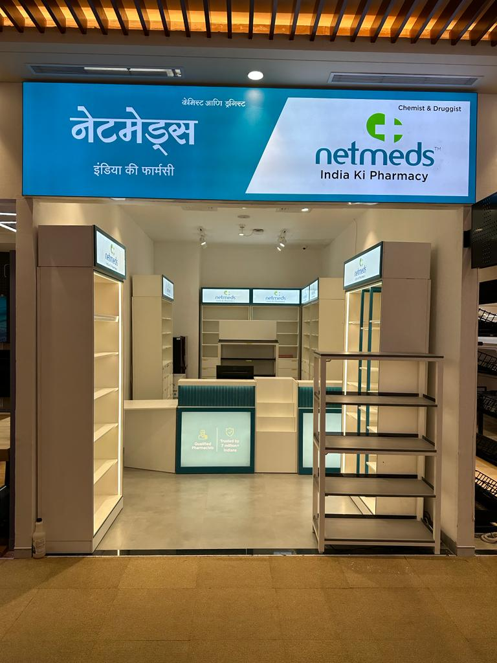
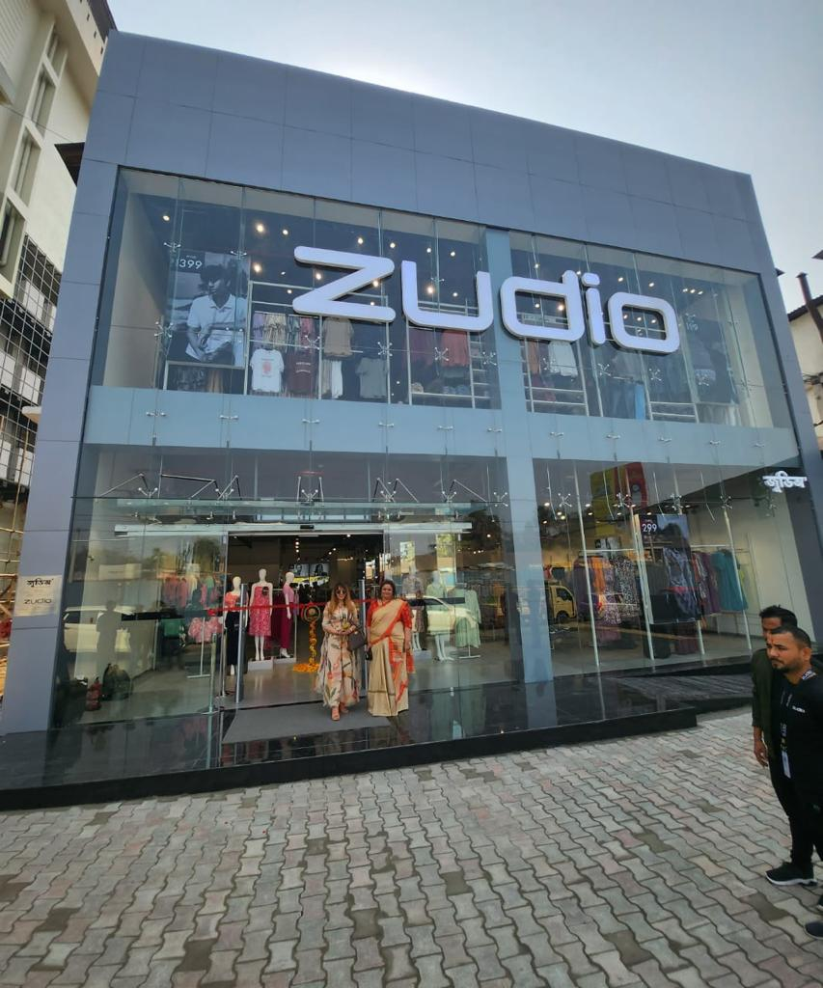
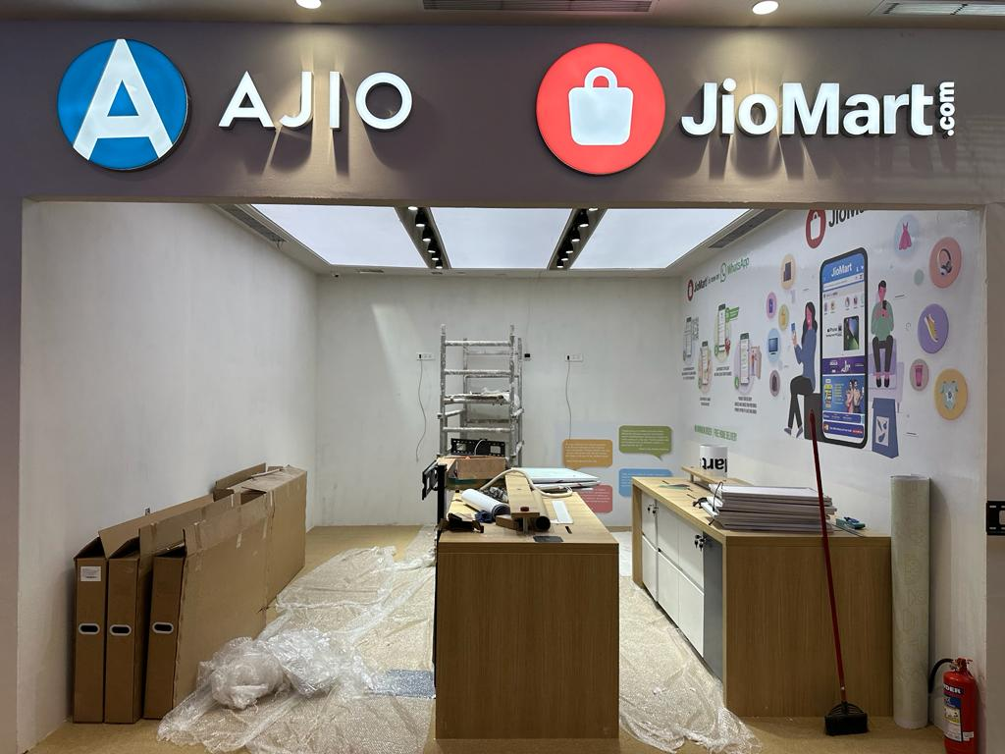

Slide 13
“Nothing can be reasonable or beautiful unless its made by
One central idea, and the idea sets every detail.
Allow us to set yours”

Slide 14
CONTACT US :-
OTEX DESIGNS LLP
PLOT NO. 36 & 37, PANCHSHEEL INDUSTRIAL AREA,
VILLAGE – KHARSUNDI, KHALAPUR, RAIGAD – 410203.
PLOT NO. 3531, AMAUSI INDUSTRIAL AREA, NADARGANJ
SAROJINI NAGAR, LUCKNOW – 226002, UTTAR PRADESH
E-mail – info@otexdesigns.in, Contact No - +91 9967589289

